Slide 1
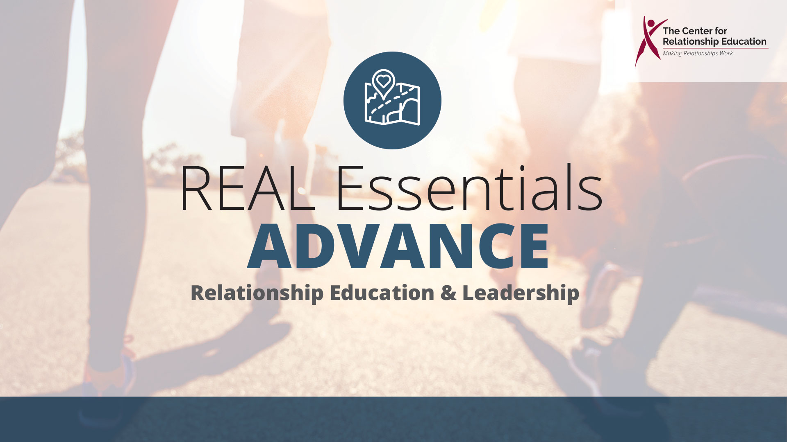
Notes:
What were you told about this class today? Why are you here? Why do you think I’m here? The reason I’m here today is teach you how to have the Best Sex! Who is ready to learn?

Slide 2





Who is Having the Best Sex?
Singles?
Married Couples?
Divorced People?
Cohabitating Couples?
Old People?
The Research Says…
Married People
©The Center for Relationship Education
Notes:
Who do you think has the best sex? Singles? Married People? Cohabitating Couples? Divorced People? Or Old People? Research continues to show us that Married People have the Best Sex. In fact, sex in marriage happens more often, is more enjoyable, and is more satisfying than in any other type of relationship. Why do you think this might be the case?
(Allow participants to answer, and repeat some of the reasons they offer. Sample answers may include, they trust one another, they feel comfortable together, they know each other’s likes and dislikes) Affirm these responses and say,
You are correct, all of these are reasons that married people have the best sex. Now here’s a question for all of you…

Slide 3
Do You Want to Have the Best Sex?
We Want You to Love Sex!
Because Sex is Awesome!
©The Center for Relationship Education
Notes:
Ask the group,
Do you want to have the Best Sex? We want you to love sex, why? Because sex is awesome. If sex wasn’t awesome, people wouldn’t do it. Here’s the thing, I’m not here to tell you not to do something. When people tell someone not to do something, what happens? Don’t touch that! Don’t drive fast! Most often when people tell you not to do something, it motivates them to test the boundaries and do it anyway. Am I right? Here’s my goal for while we are together. I’m going to give you amazing information, and I want to challenge you to think and determine for yourself what’s best.

Slide 4
Why does something intended for bringing people together often tear relationships apart?
©The Center for Relationship Education
Notes:
I told you earlier that sex is awesome, and that is definitely true. Let’s be real for a minute and talk about how sex, although great, can cause people a lot of pain in relationships. Don’t raise your hand, but think honestly about this question. How many of you know someone, or have been someone, who has been hurt because of this? Isn’t crazy how the one thing that is supposed to bring people closer in relationships can do the most damage and tear people apart?

Slide 5

Sex?
What is Sex?
©The Center for Relationship Education
Notes:
What is sex?
(Summarize participant answers. As you hear answers, students typically capture different forms of sex (intercourse, oral, anal).
Sex is defined as any genital contact. If sexual organs are engaged in the actions, then a form of sex is happening.
Is there such a thing as friends with benefits?
(Allow student to answer. Many will argue yes and try and explain why). Follow their explanation with,
There is no such thing as friends with benefits. Think about this. What words would you use to describe a good friend?
(Answers may include: they protect one another, they respect each other, they think about others before themselves).
You just told me characteristics of a true friend. There is only one label for people who use someone else for their bodies. I do not want you to be associated with that group. A true friend would never take advantage of you, and a friend who is using you for your body for their own selfish desires, is not really a friend.

Slide 6
Friends with Benefits?
If you are in a relationship where these behaviors are happening, it would be a be a benefit to your friendship to define the relationship as romantic.
©The Center for Relationship Education
Notes:
Before the build to the isolated word “Sex”: “If sex wasn’t awesome, people wouldn’t do it. Here’s the thing, I’m not here to tell you not to do something. When people tell someone not to do something, what happens? Don’t touch that! Don’t drive fast! Most often when people tell you not to do something, it motivates them to test the boundaries and do it anyway. Am I right? Here’s my goal for while we are together. I’m going to give you amazing information, and I want to challenge you to think and determine for yourself what’s best.”
Next to the build with “Sex” Isolated at the top of slide:
“Before we talk about the affect sex has on relationships, I need to ask you to answer this question. What is sex?” (Summarize participant answers. As you hear answers, students typically capture different forms of sex (intercourse, oral, anal). “Sex is defined as any genital contact.” If sexual organs are engaged in the actions, then a form of sex is happening.”
Next to build with “Why does something intended….”
“I told you earlier that sex is awesome, and that is definitely true. Let’s be real for a minute and talk about how sex, although great, can cause people a lot of pain in relationships. Don’t raise your hand, but think honestly about this question. How many of you know someone, or have been someone, who has been hurt because of this? Isn’t crazy how the one thing that is supposed to bring people closer in relationships can do the most damage and tear people apart? We need to be real about this and talk about why this is true.
Next to Friends with Benefits build:
“Is there such a thing as friends with benefits?” (Allow student to answer. Many will argue “yes” and try and explain their why). Follow their explanation with, “There is no such thing as friends with benefits. Think about this. What words would you use to describe a good friend? (Answers may include: they protect one another, the respect each other, they think about others before themselves). “You just told me true characteristics of a true friend. There is only one label for people who use someone else for their bodies. I do not want you to be associated with that group. A true friend would never take advantage of you, and a friend who is using you for your body for their own selfish desires, is not really a friend.”

Slide 7

Humans vs. Animals
©The Center for Relationship Education
Notes:
How many of you have a dog? Let me tell you a story about a dog and see if you can predict what happens. Let’s say you’re at the park, and you see someone with a strong, athletic black lab. We’ll call him Fido. Just across the pond, Fido sees a gorgeous, newly groomed golden retriever chasing a frisbee. We’ll call her, Goldie. Goldie’s glistening golden coat blows in the wind, and the sun catches the reflection of her sparkling rhinestone collar. She catches the frisbee with grace and poise. She’s both gorgeous and athletic. Fido heads toward Goldie, when a mutt, with matted fur, runs his direction. This matted mutt, Mattie, just happens to be in heat. Which dog does Fido pick to date? Mattie! Why? It’s because of the word the drives the animal kingdom to mate. It starts with an “I”. Can you guess? The word is Instinct. Humans, however, pair up with romantic partners being driven by another “I” word. Can you guess? That word is Intellect. When it comes to relationships and sex, humans have the capacity to use their intellect, and not their instinct, to make healthy choices about their sexual behavior.

Slide 8
What do we need to live?
Needs
Desire
©The Center for Relationship Education
Notes:
Something else that is incredible about human beings is our drive to survive in even the most challenging circumstances. Some people call this wiring Resiliency. Let’s talk about what it takes to survive. What do human beings need to live?
(Allow students to brainstorm. Examples may be air, water, shelter, food). Then ask,
what do humans desire in life?
(Allow students to answer. Some answers may be nice clothes, fancy homes, cool cars). Then ask,
on which side of the chart does sex go?
(Let students discuss this question).
Sex is actually a desire. No one has ever seen a tombstone that reads, Lies here because they didn’t get any!

Slide 9

Who Says It’s OK to Have Sex As Teenagers?
What is their motivation?
©The Center for Relationship Education
Notes:
Let’s talk about the messages we hear about sex. Who usually says it is OK to have sex as teenagers?
(Answers may include media, friends, the person you are dating)
What is their motivation?
(Answers may include money or peer pressure).

Slide 10

Who Advises You to Wait?
What is their motivation?
©The Center for Relationship Education
Notes:
Who advises you to wait to have sex?
(Answers may include parents, doctors, mentors).
What is their motivation?
(Answers may include they care about you, they don’t want to see you hurt, they love you).

Slide 11

Why Do People Have Sex?
©The Center for Relationship Education
Notes:
What’s the motivation for having sex at all? Why do people do it?
(Answers may include because it feels great, to have a family, because they love each other).

Slide 12

©The Center for Relationship Education
Notes:
Who here has ever been in weather like this? It’s freezing, it’s dark. It’s no fun. Imagine you have walked a long distance in conditions like this, and when you finally get home, someone has built a wood burning fire in your living room.

Slide 13

©The Center for Relationship Education
Notes:
What words would you use to describe the feelings you experience when coming home to a wood burning fire?
(Answer may include cozy, warm, comfortable, safe, relaxed).
Now, shift gears for a minute, and imagine arriving home from that same walk through the blizzard to this…

Slide 14

©The Center for Relationship Education
Notes:
What would you feel in this circumstance?
(Answer may include panicked, fearful, chaotic, burned, hurt). Follow their list of feeling words by saying,
Remember when I talked about the research that married people have the best sex? This illustration helps us understand why. A committed lifetime partnership acts like the bricks of a fireplace. It creates a safe space for sex to stay cozy, warm, comforting, and hot. Sex outside these boundaries, however, can burn you or create chaos instead of safety.

Slide 15
I Want You to Have the:
Best Relationships
Best Sex
Best Life
©The Center for Relationship Education
Notes:
I want you to have the best relationships, best sex, and best life! The relationship skills I’m going to teach you will help each of you accomplish this goal.

